Slide 1
Project 02 :Ames housing price predictions
Michelle | Abirami | Jerome
11th October 2019

Slide 2
Table of contents
1. Which Housing Features are Good Indicators of Housing Price?
2. Cleaning Process
3. Imputation of Missing Values
4. Statistical Inference
5. Feature Selection (Collinearity Test)
6. Modeling + Further Tweaks
7. Conclusion

Slide 3

Which Housing Features are Good Indicators of Housing Price?

Slide 4
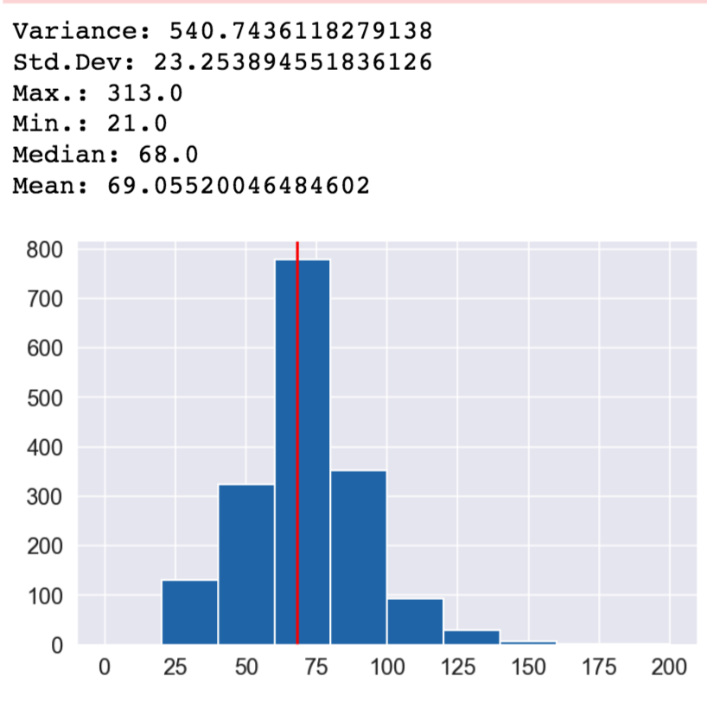
CLEANING PROCESS
Cleaned column names for quicker manipulation of data
Created function to explore outliers while getting better overview of each feature
Checked for missing values
Manually imputed ordinal values with numerical values

Slide 5
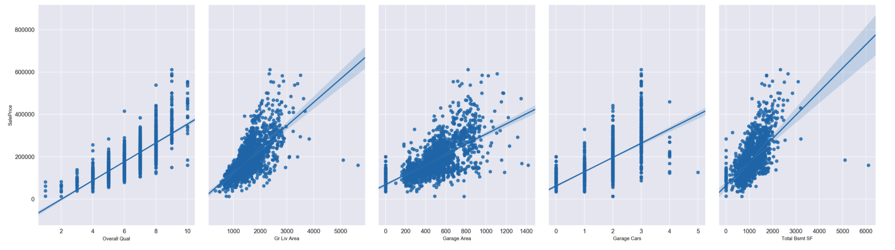
IMPUTATION OF MISSING VALUES
Replaced values with either median, mean, zero value or NA (depending on original data type of feature)
Applied linear regression to impute values with vast amount of missing values eg. Lot Frontage (found features highly correlated to Lot Frontage and used it’s existing values to predict missing values)

Slide 6
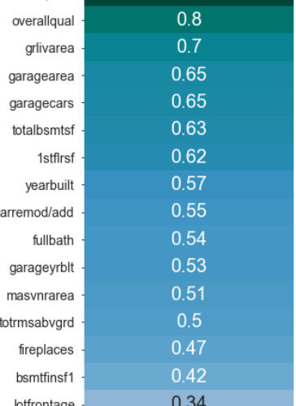
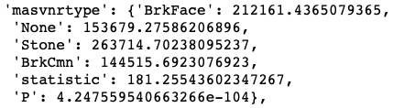
STATISTICAL INFERENCE
Heatmap of Continuous Variable in Correlation to Sale Price
Statistical Inference Tests:
Categorical Variables:
Difference in Variance measure by ANOVA against saleprice
Continuous Variables:
Correlation matched with saleprice

Slide 7

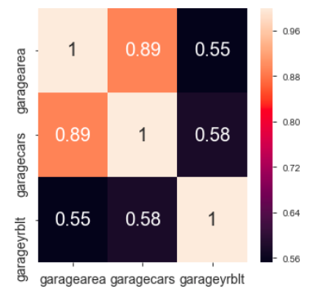
FEATURE SELECTION
Most collinear variables are removed using variance inflation factor (Variables with a VIF of 5 or more is taken out, with the exception of a highly correlated value (>0.8)
Features were futher tweaked and selected after evaluating models (Ridge & LASSO)

Slide 8
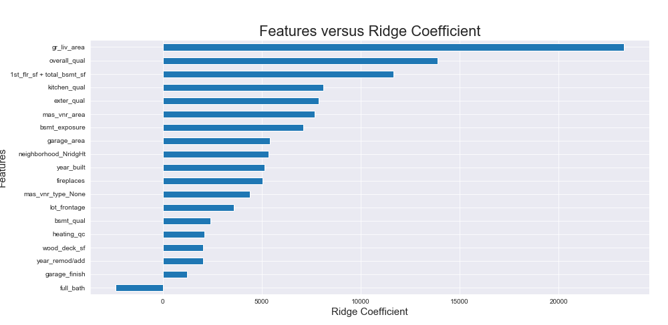
MODELING
Features affecting Saleprice:
Full Bath – Negative influence
Gr_liv area High Influence
Year built and Area – Higher influence
Mulitiply coefficent by per unit increase in the features
Notes:
Observed the effects of Ridge & LASSO models to choose the features. I tried Linear, Elastic Net, & LASSO. I settled on Ridge because it has lowest RMSE.

Slide 9
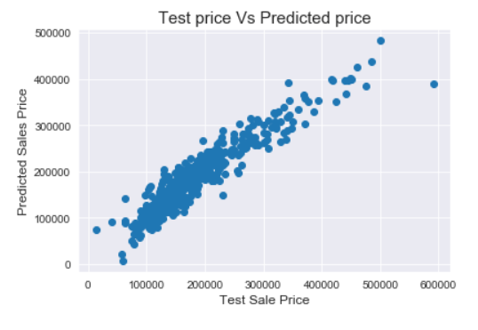
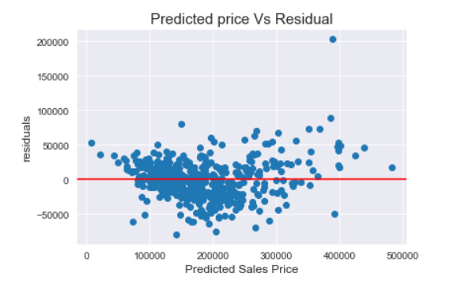
CONCLUSION
Final features selected:
Masonry Area
Garage Living Area
Total Basement Square Feet
Year Built
Exterior Quality
Basement Quality
Kitchen Quality
Model Accuracy: Average Error = 27087.94

Slide 10
Thank you
Any questions?

Slide 11
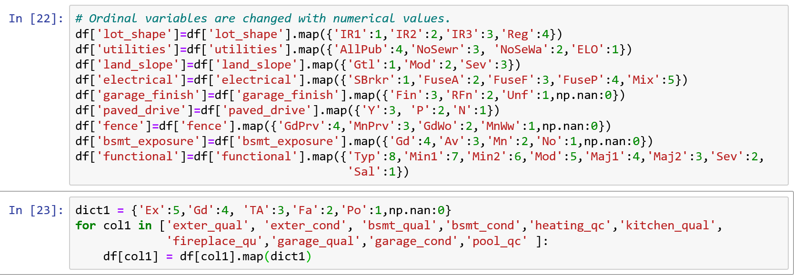
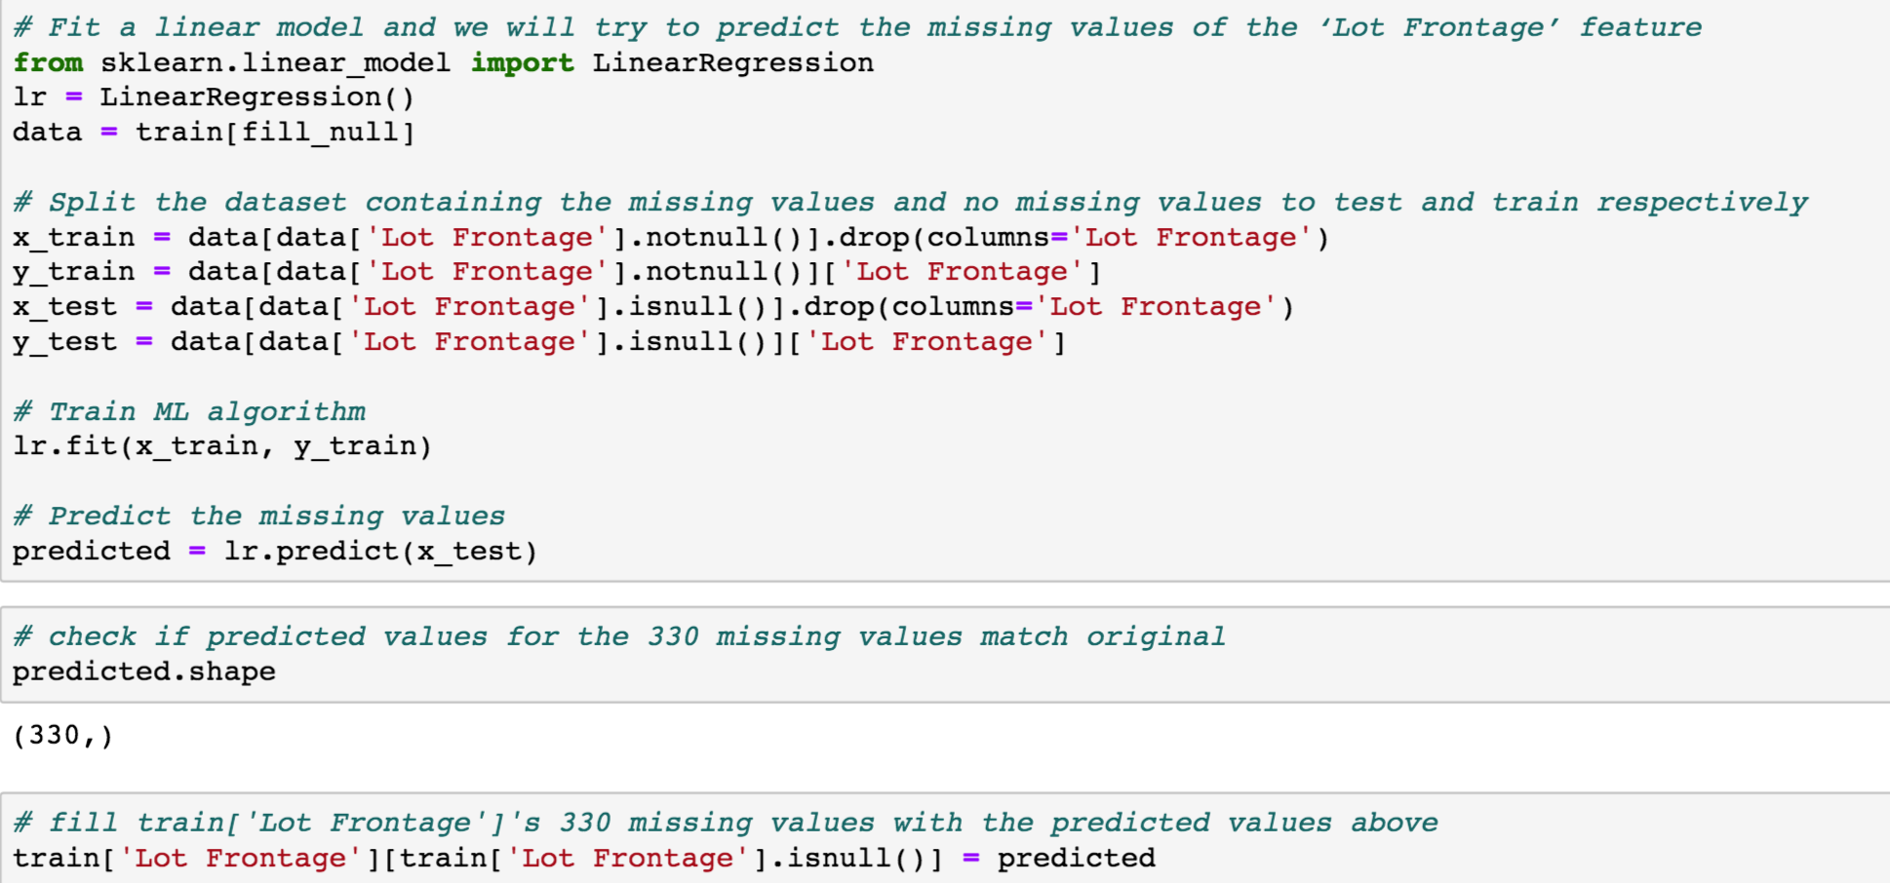
Code snippets
Ordinal Encoding (manually)
Linear Regression for handling missing values for ‘Lot Frontage’

Slide 12
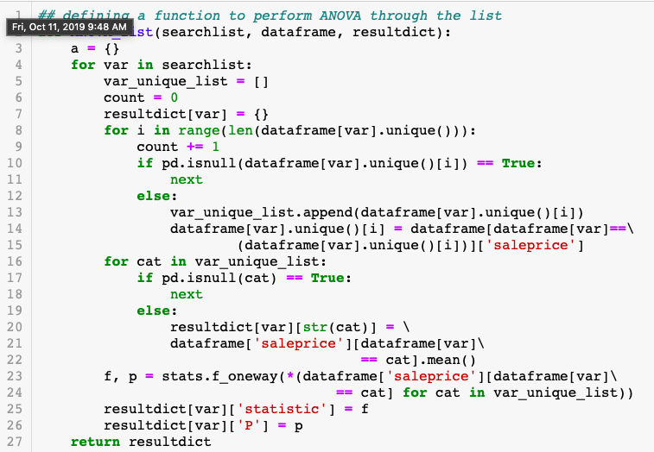
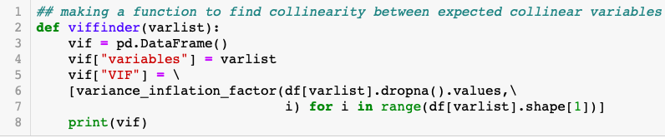
Code snippets
ANOVA
VIF

Slide 13
